Slide 1
Removing Unwanted Caption from Snapchat Images
Matt Giovannucci
David Tigreros

Slide 2
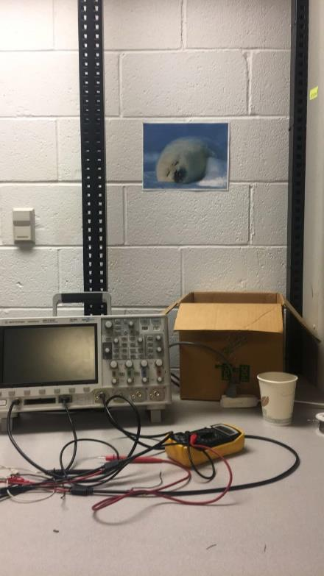
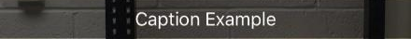

Slide 3
Several Pre-existing methods
CapSnap, Python Based program
CaptionClean – iPhone App

Slide 4
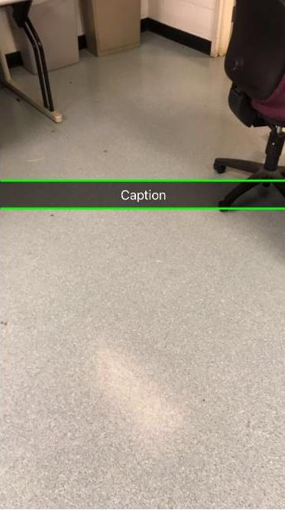
Isolating Snapchat bar
Using the Hough transform to find straight lines within picture
Filter the lines to only look for horizontal lines

Slide 5
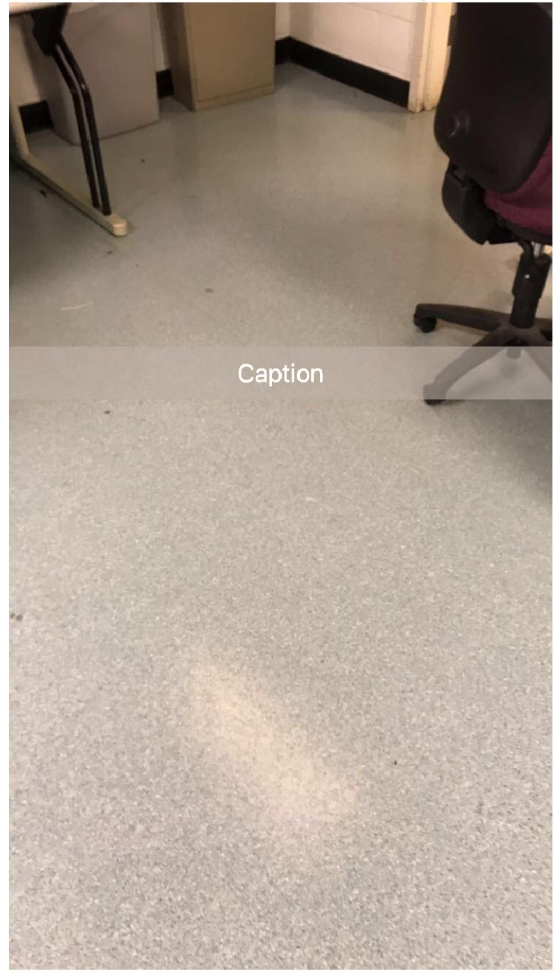
Blend snapchat bar into the surrounding picture
Average surrounding pixels into the picture
Take five random rows surrounding the bar and find the average difference between each RGB value of a random pixel within the bar in the same row

